Slide 1


Billy Koech
27th March 2033

Slide 2

Outline
Executive Summary
Introduction
Methodology
Results
Conclusion
Appendix

Slide 3
Executive Summary
SpaceX’s success is mainly attributed to it’s ability to reuse first stage parts of it’s rockets. Some of it’s attempts to land the first stage have been both a success and a failure. In this project we use machine learning to try and determine whether the success of landing can be predicted using rocket launch conditions and some other features.
The data for this project was collected through the SpaceX API and by scraping Wikipedia. The data was cleaned and features to be used in the models selected.
Classification models were trained and the best model had an accuracy of 0.833. The models did a good job in predicting rockets that successfully landed and a bad job in predicting rockets that failed to land.

Slide 4
Introduction
SpaceX has gained worldwide attention for a series of historic milestones. It is the only private company ever to return a spacecraft from low-earth orbit, which it first accomplished in December 2010.
SpaceX advertises Falcon 9 rocket launches on its website with a cost of 62 million dollars whereas other providers cost upward of 165 million dollars each, much of the savings is because Space X can reuse the first stage.
Therefore if we can determine if the first stage will land, we can determine the cost of a launch. This information can be used if an alternate company wants to bid against SpaceX for a rocket launch.

Slide 5

Section 1

Slide 6
Methodology
Methodology Outline
Data collection using:
SpaceX API
Web Scrapping
Data wrangling
Exploratory data analysis (EDA) using visualization and SQL
Interactive visual analytics using:
Folium
Plotly Dash
Predictive analysis using classification models

Slide 7
Data Collection
The data for the project was collected using two main methods:
Using the spaceX API. The rocket launch data from SpaceX was requested from the following url https://api.spacexdata.com/v4/launches/past
By performing web scraping to collect Falcon 9 history records from a Wikipedia page titled List of Falcon 9 and Falcon Heavy Launches. https://en.wikipedia.org/wiki/List_of_Falcon_9_and_Falcon_Heavy_launches

Slide 8
Data Collection – SpaceX API
Request made to collect rocket launch data. requests.get(="https://api.spacexdata.com/v4/launches/past")
Jupyter Notebook
SpaceX rocket launch data.
Response received having the rocket launch data.
response.status_code()
--> 200
GitHub link:
https://github.com/billykoech137/spacex_falcon9_project/blob/main/jupyter-labs-spacex-data-collection-api.ipynb

Slide 9
Data Collection - Scraping
Using Beautiful Soup to extract the relevant tables form the Wikipedia page:
response = requests.get(static_url).text
soup = BeautifulSoup(response)
soup.find_all('table',"wikitable plainrowheaders collapsible")
df=pd.DataFrame(launch_data)
Wikipedia:
List of Falcon 9 and Falcon Heavy Launches
Structured Data in a pandas Data Frame
GitHub link:
https://github.com/billykoech137/spacex_falcon9_project/blob/main/jupyter-labs-webscraping.ipynb

Slide 10
Data Wrangling
The following were performed:
Calculating the total launches on each site.
Calculating the number of occurrence of each orbit
Calculating the number of occurrence of mission outcome per orbit type
Creating landing outcome label from the outcome column
GitHub URL:
https://github.com/billykoech137/spacex_falcon9_project/blob/main/labs-jupyter-spacex-Data%20wrangling.ipynb

Slide 11
EDA with Data Visualization
The following charts were plotted.
Scatter plots: Used to show relationship between continuous variables.
Categorical plots: Used to show relationship between categorical and continuous variables.
Bar Chats: Used to show representation of categorical variables
Line graphs : Used to show trend line.
GitHub URL:
https://github.com/billykoech137/spacex_falcon9_project/blob/main/labs-jupyter-spacex-Data%20wrangling.ipynb

Slide 12
EDA with SQL
The following SQL queries were performed
Displayed the names of the unique launch sites in the space mission
Displayed 5 records where launch sites begin with the string 'CCA'
Displayed the total payload mass carried by boosters launched by NASA (CRS)
Displayed average payload mass carried by booster version F9 v1.1
Displayed a list of the dates when the first successful landing outcome in ground pad was achieved.
Displayed a list of the names of the boosters which have success in drone ship and have payload mass greater than 4000 but less than 6000
Displayed a list of the total number of successful and failure mission outcomes
Displayed a list the names of the booster versions which have carried the maximum payload mass. Use a subquery
Displayed a list of the records which will display the month names, failure landing outcomes in drone ship ,booster versions, launch site for the months in year 2015.
Ranked the count of successful landing outcomes between the date 04-06-2010 and 20-03-2017 in descending order.
GitHub URL:
https://github.com/billykoech137/spacex_falcon9_project/blob/main/jupyter-labs-eda-sql-coursera_sqllite.ipynb

Slide 13
Build an Interactive Map with Folium
The following map objects were used:
Markers: Used to specific location.
Circles: used to add highlighted circle area with a text label on a specific launch site coordinates.
Lines: draw a line from the different site location to the shoreline.
MarkerCluster: used to add many markers having similar coordinates.
GitHub URL:
https://github.com/billykoech137/spacex_falcon9_project/blob/main/lab_jupyter_launch_site_location.ipynb

Slide 14
Build a Dashboard with Plotly Dash
The following plots/graphs and interactions were added to a dashboard:
A scatter plot showing the correlation between payload mass and success
A pie chart showing Total Success Launches By Site
GitHub URL:
https://github.com/billykoech137/spacex_falcon9_project/blob/main/Dashboard/spacex_dash_app.py

Slide 15
Predictive Analysis (Classification)
The following steps were taking during the predictive analysis using classification models:
Features X and target Y were determined.
The data was then split 80-20. 80% for training and 20% for validation.
The following models were then trained on the data and the best performing model was selected.
Logistic Regression
Support Vector Machine
K Nearest Neighbor
Decision Tree Classifier
GitHub URL:
https://github.com/billykoech137/spacex_falcon9_project/blob/main/SpaceX_Machine%20Learning%20Prediction_Part_5.ipynb

Slide 16
Results
Exploratory data analysis results
Interactive analytics demo in screenshots
Predictive analysis results

Slide 17

Section 2

Slide 18
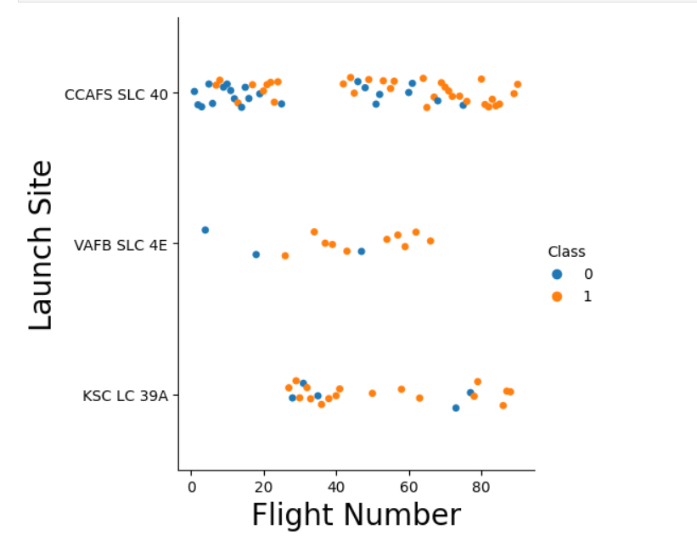
Flight Number vs. Launch Site
VAFB SLC has the least number of flights while CCAFS has the highest number of flights.

Slide 19
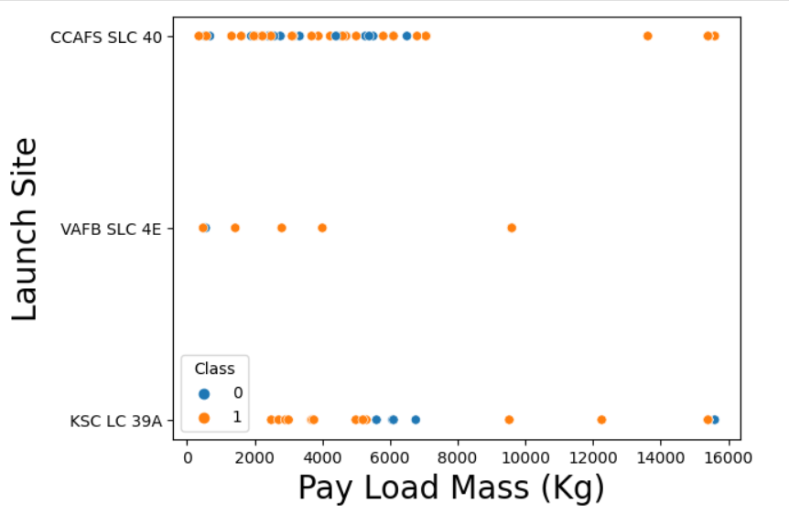
Payload vs. Launch Site
For the VAFB-SLC launch site there are no rockets launched for heavy payload mass(greater than 10000)

Slide 20
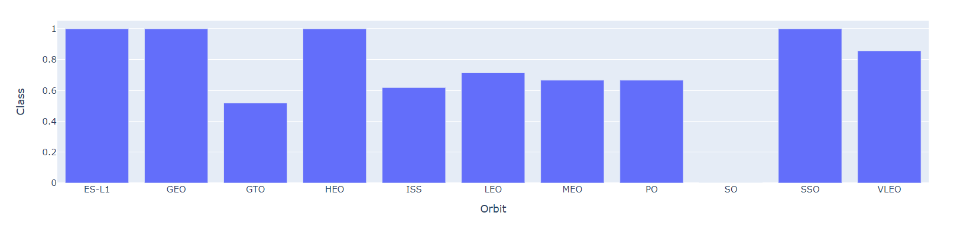
Success Rate vs. Orbit Type
ES-L1, GEO, LEO, SSO have the highest success rates.
SO has the lowest success rate.

Slide 21
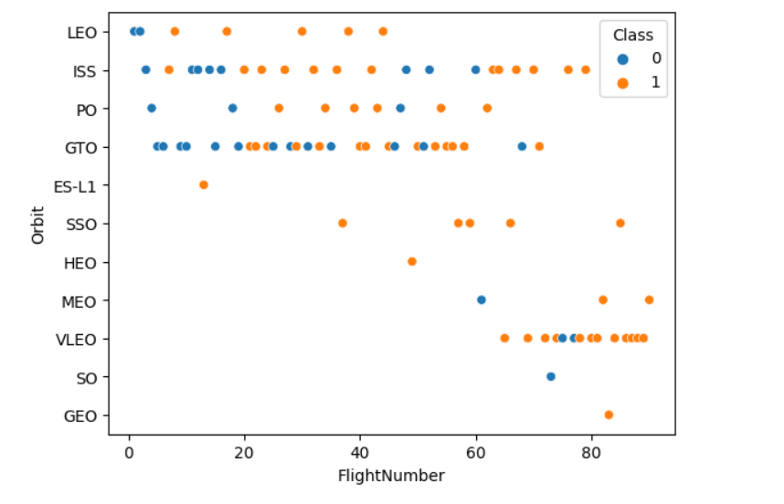
Flight Number vs. Orbit Type
For the LEO orbit the Success increases with number of flights.
There is no relation between flight number and success for the other orbits.

Slide 22
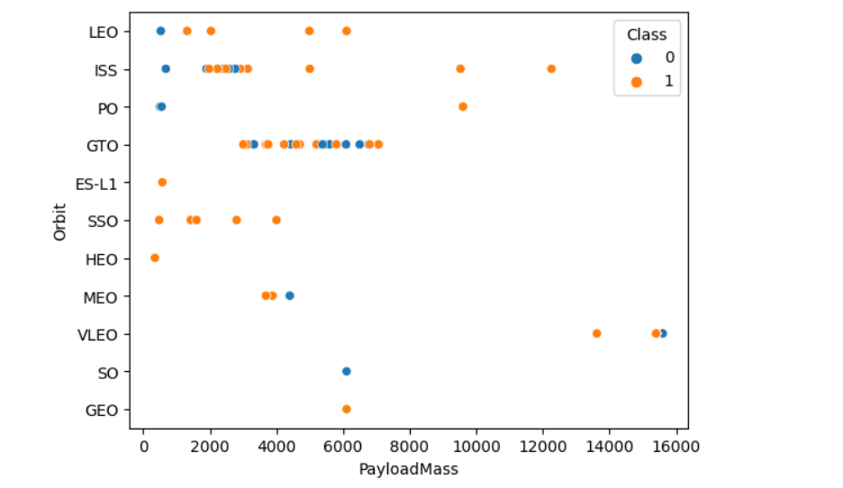
Payload vs. Orbit Type
With heavy payloads the successful landing rate are more for LEO, ISS and Polar.
For GTO, there is no relationship between payload mass and success rate.

Slide 23
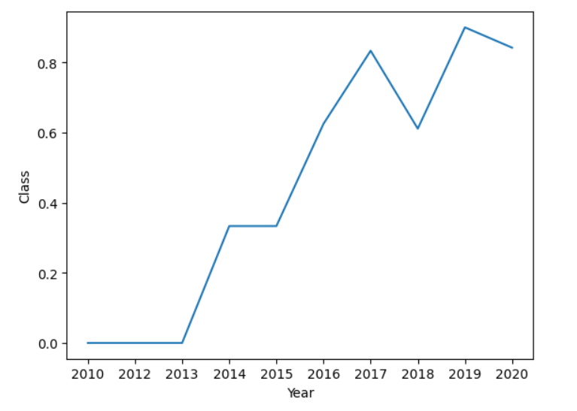
Launch Success Yearly Trend
The since 2013 kept increasing till 2020

Slide 24
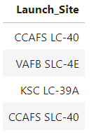
All Launch Site Names
CCAFS LC-40: Cape Canaveral Air Force Station Launch Complex 40
VAFB SLC-4E: Vandenberg Space Force Base Space Launch Complex 4E
KSC LC-39A: Kennedy Space Center Launch Complex 39A
CCAFS SLC-40: Cape Canaveral Air Force Station Space Launch Complex 40

Slide 25
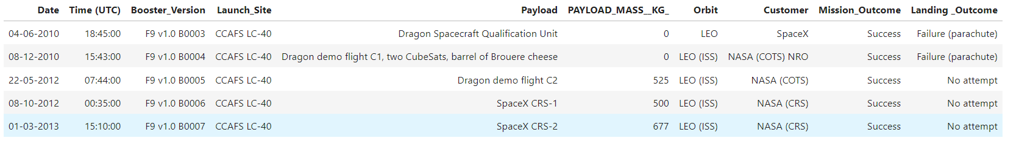
Launch Site Names Begin with 'CCA'
These are launches that happened at Cape Canaveral Air Force Station

Slide 26
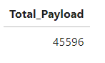
Total Payload Mass
Total payload carried by boosters from NASA

Slide 27
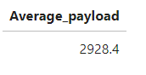
Average Payload Mass by F9 v1.1
The average payload mass carried by booster version F9 v1.1

Slide 28
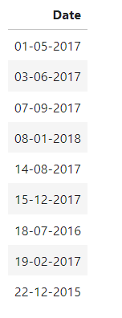
First Successful Ground Landing Date
Dates of the first successful landing outcome on ground pad

Slide 29
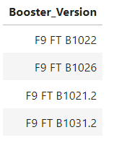
Successful Drone Ship Landing with Payload between 4000 and 6000
Names of boosters which have successfully landed on drone ship and had payload mass greater than 4000 but less than 6000

Slide 30
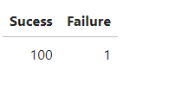
Total Number of Successful and Failure Mission Outcomes
Total number of successful and failure mission outcomes

Slide 31
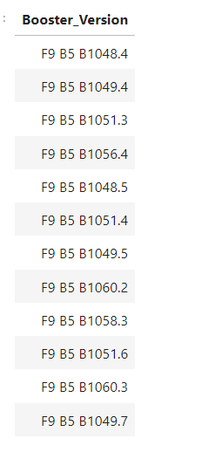
Boosters Carried Maximum Payload
Names of the booster which have carried the maximum payload mass

Slide 32
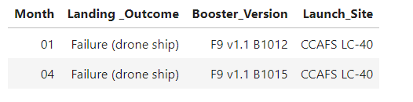
2015 Launch Records
Failed landing outcomes in drone ship, their booster versions, and launch site names for in year 2015

Slide 33
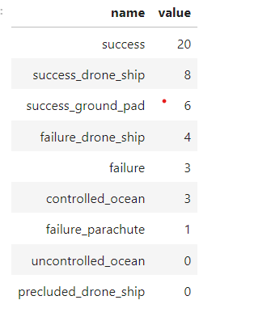
Rank Landing Outcomes Between 2010-06-04 and 2017-03-20
Count ranking of landing outcomes between the date 2010-06-04 and 2017-03-20, in descending order

Slide 34

Section 3

Slide 35
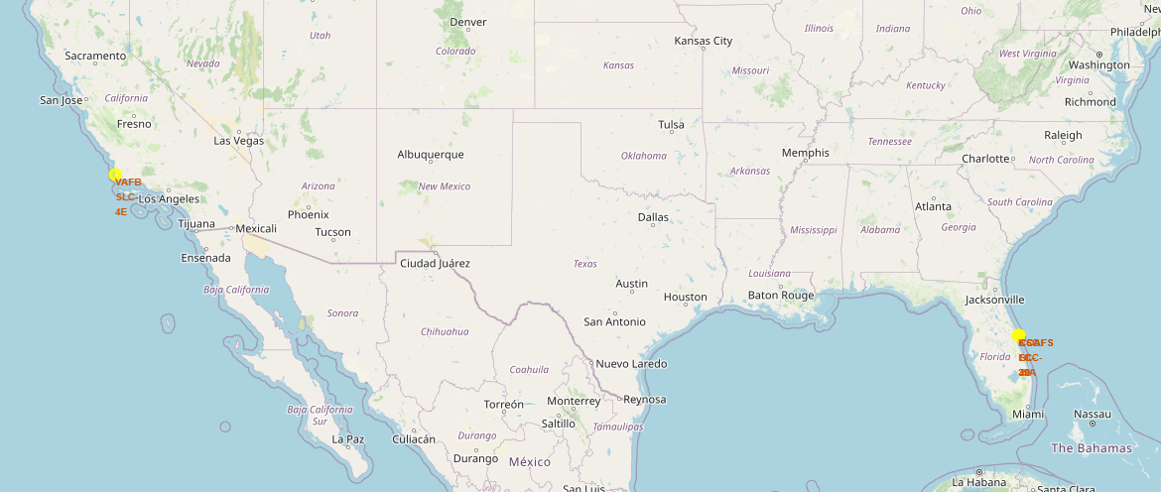
Map Showing Locations of the Launch Sites
Launch sites’ location markers on a global map
Shows the different coordinates of the launch site locations on the global map.

Slide 36
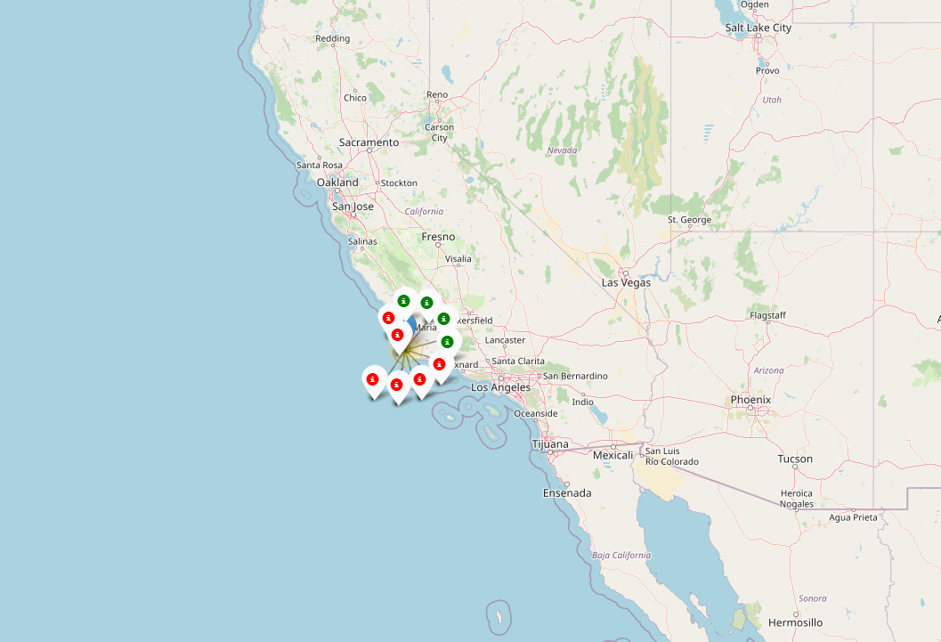
Color-labeled Launch Outcomes
Color-labeled launch outcomes on the map

Slide 37
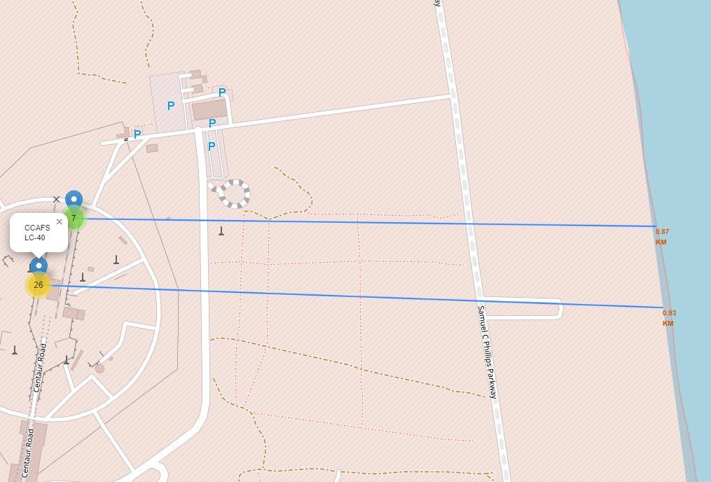
Distance to the Coastline
Distance of Cape Canaveral Air Force Stations to the coastline.

Slide 38

Section 4

Slide 39
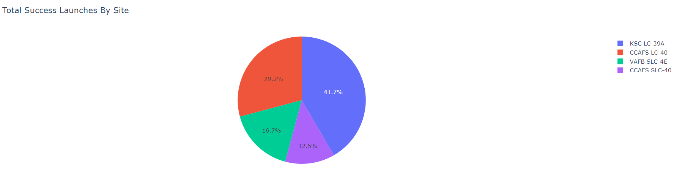
Launch Success Count for all Sites
Pie chart showing launch success count for all sites.

Slide 40
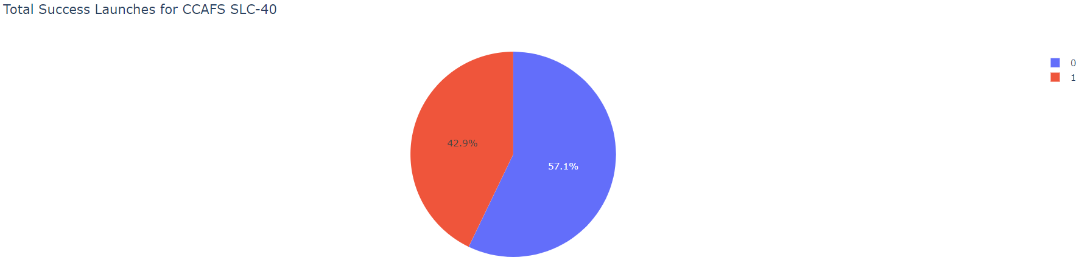
Pie chart Showing Success Launches
Pie chart showing the success ratio for the Cape Canaveral Air Force Station Space Launch Complex 40

Slide 41
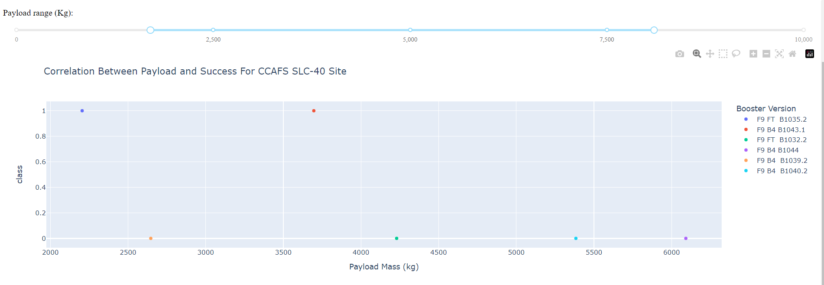
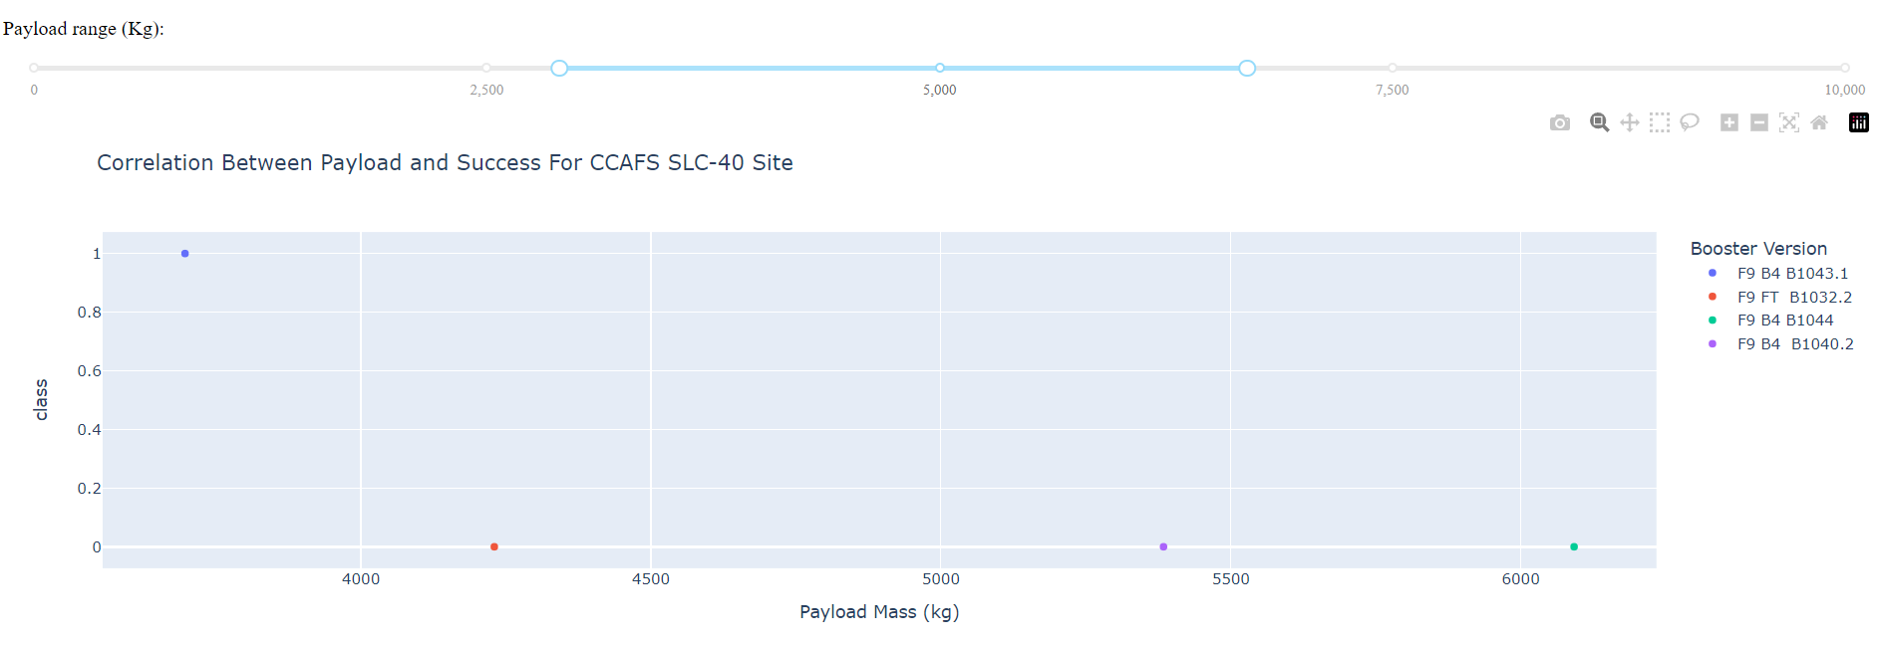
Payload Vs. Launch Outcome
Payload vs. Launch Outcome scatter plot for all sites, with different payload selected in the range slider

Slide 42

Section 5

Slide 43
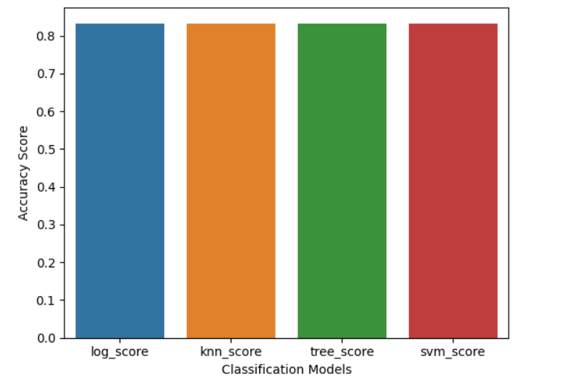
Classification Accuracy
All the models have the same classification accuracy of 83.33%

Slide 44
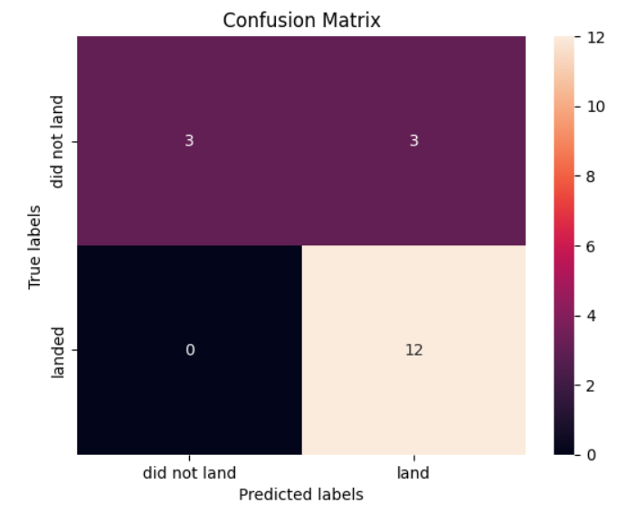
Confusion Matrix
True Positives: 12
False Positives: 0
True Negatives: 3
False Negative: 3
The models did a good job predicting rockets that landed.

Slide 45
Conclusions
The classification models did well predicting the rockets that landed. More tuning of the models should be done to improve it’s accuracy of predicting rockets that did not land.

Slide 46
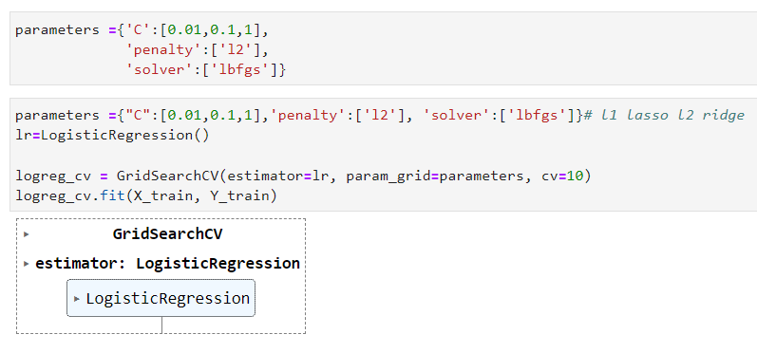
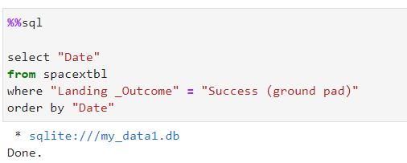
Appendix
Code showing model training
SQL code

Slide 47


